Slide 1

Predicting Our Dream Home's Price
A Complete Data Science Deep Dive with Machine Learning
From data loading and cleaning to model training and evaluation, explore how machine learning algorithms predict house prices with accuracy and insight. A comprehensive journey through the entire data science pipeline.
17 Slides
Prepared By Mohamad Oomer Habib Moussa

Slide 2
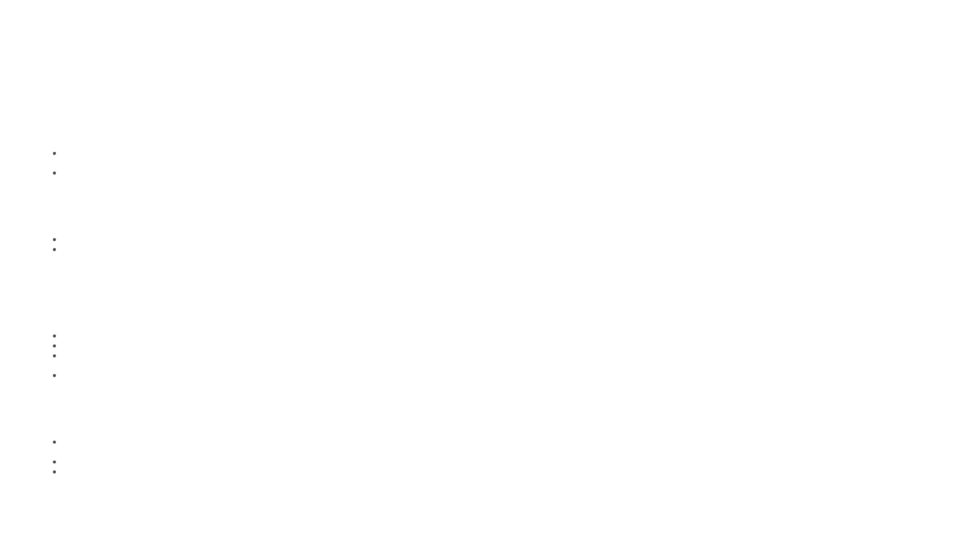
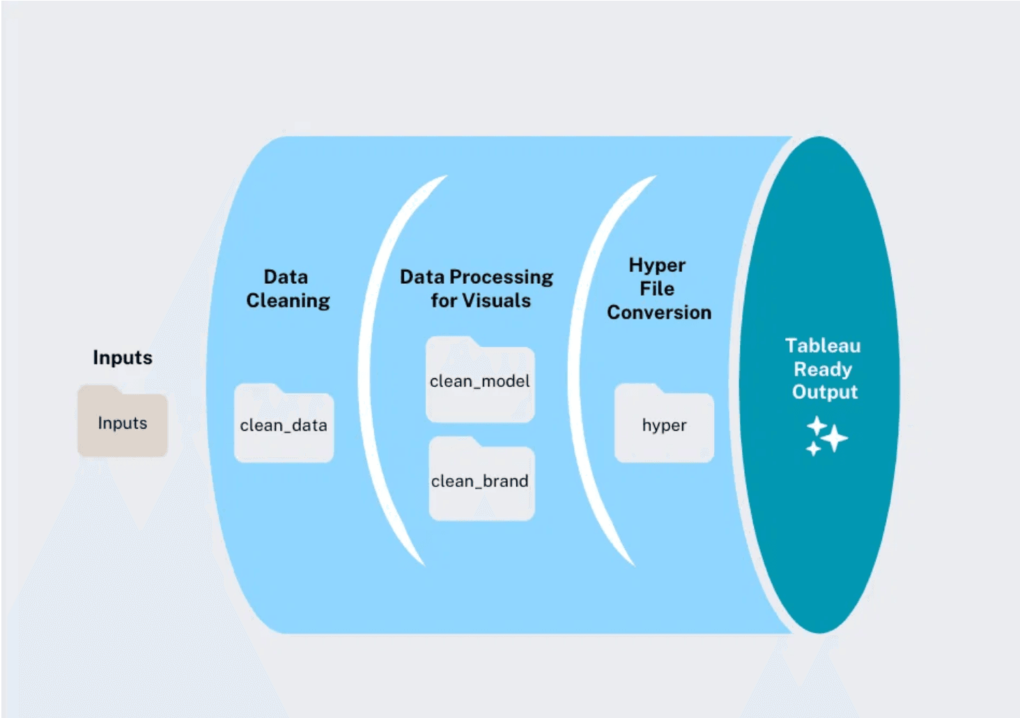
Our Digital Toolkit
Python Libraries for Data Science
import pandas as pd
import numpy as np
Pandas
Loads CSV data into DataFrames. Cleans, filters, and manipulates data. Handles missing values and outliers.
pandas (pd):
Data manipulation and analysis library. Handles DataFrames (tables of data).
numpy (np):
NumPy
Numerical computing library. Performs mathematical and array operations.
Performs numerical calculations. Computes statistics (mean, std, quantiles). Powers mathematical operations.
import matplotlib.pyplot as plt
import seaborn as sns
matplotlib:
Plotting library for creating charts and visualizations.
Matplotlib & Seaborn
seaborn (sns):
Creates visualizations: histograms, boxplots, heatmaps, scatter plots. Helps understand data patterns.
Statistical visualization library built on matplotlib. Creates beautiful heatmaps and plots.
from sklearn.model_selection import train_test_split
from sklearn.linear_model import LinearRegression
from sklearn.tree import DecisionTreeRegressor
from sklearn.ensemble import RandomForestRegressor
Scikit-learn
Machine learning toolkit. Provides models (Linear Regression, Decision Tree, Random Forest) and evaluation metrics.
train_test_split:
Splits data into training and testing sets.
LinearRegression:
Simple linear model for predictions.
DecisionTreeRegressor:
Tree-based model for non-linear predictions.
RandomForestRegressor:
Ensemble of trees for robust predictions.
from sklearn.metrics import r2_score, mean_absolute_error, mean_squared_error
r2_score:
Calculates R² (coefficient of determination) for model accuracy.
Toolkit Overview: These libraries form a complete data science pipeline: load data (Pandas), analyze (NumPy), visualize (Matplotlib/Seaborn), and predict (Scikit-learn).
mean_absolute_error:
Calculates average prediction error.
mean_squared_error:
Calculates squared error (penalizes large errors).

Slide 3
Finding Our Data Home
Loading the Housing Dataset from Kaggle
#1 – Import Pandas Library
import pandas as pd
Dataset Overview
import pandas as pd:
Imports the Pandas library and gives it a short alias 'pd' for easier use.
Total Records:
545 houses
Pandas:
A powerful library for data manipulation, analysis, and cleaning.
Total Features:
13 columns
Data Type:
CSV (Kaggle)
#2 – Load CSV File
df = pd.read_csv('Housing.csv')
Target Variable:
price (₨)
pd.read_csv():
Reads a CSV (Comma-Separated Values) file and converts it into a DataFrame.
Price Range:
₨1.1M - ₨33M
'Housing.csv':
The filename containing house price data from Kaggle.
df:
Variable name for the DataFrame (a table-like structure with rows and columns).
Result:
A DataFrame with all housing data ready for analysis.
Dataset Features
Numerical: price, area, bedrooms, bathrooms, stories, parking Categorical: mainroad, guestroom, basement, hotwaterheating, airconditioning, prefarea, furnishingstatus Total: 13 features for predicting house prices
#3 – Give a Sample of the Data, preview the first 5 Rows
df.head()
.head():
Shows the first 5 rows of the DataFrame by default.
Data Loading Insight: The Housing dataset from Kaggle contains 545 house records with 13 features including price, area, bedrooms, bathrooms, and various amenities. This data will be cleaned, analyzed, and used to train our machine learning models to predict house prices accurately.
Purpose:
Quick visual inspection of the data structure and values.
Alternative:
df.head(10) shows first 10 rows.
#4 – View Column Names
df.info()
.columns:
Displays the names of all columns in the DataFrame.
Output:
Lists features like 'price', 'area', 'bedrooms', 'bathrooms', etc.
Purpose:
Helps understand what data we have available for analysis.

Slide 4
First Look at Our New Dataset
Data Inspection and Statistical Summary
#1 – View First 5 Rows
df.head()
Sample Data df.head()
.head():
Displays first 5 rows of the DataFrame.
Price
Area
Bed
Bath
Stories
Park
Purpose:
Quick visual inspection of data structure and values.
13.3M
7420
4
2
3
2
12.25M
8960
4
4
4
3
#2 – Get Data Info
df.info()
12.25M
9960
3
2
2
2
12M
7500
4
2
4
3
.info():
Shows column names, data types, and non-null counts.
11.41M
7420
4
1
2
2
Output:
Identifies int64, object, float64 data types.
Reveals:
Which columns have missing values (non-null count < total rows).
Statistical Summary df.describe()
#3 – Statistical Summary
df.describe()
Stat
Price (₨M)
Area (sqft)
Bedrooms
Count
545
545
545
.describe():
Calculates statistics for numeric columns.
Mean
4.77
5150
2.96
Metrics:
count, mean, std, min, 25%, 50%, 75%, max.
Std
2.41
2313
0.89
Interpretation:
Understand data distribution and ranges.
Min
1.1
1650
1
50%
3.85
4600
3
Max
33
16200
6
Key Observations: Average house price is ₨4.77M with significant variation (std: ₨2.41M). Most houses have 3 bedrooms and ~4600 sqft area. No missing values detected.

Slide 5

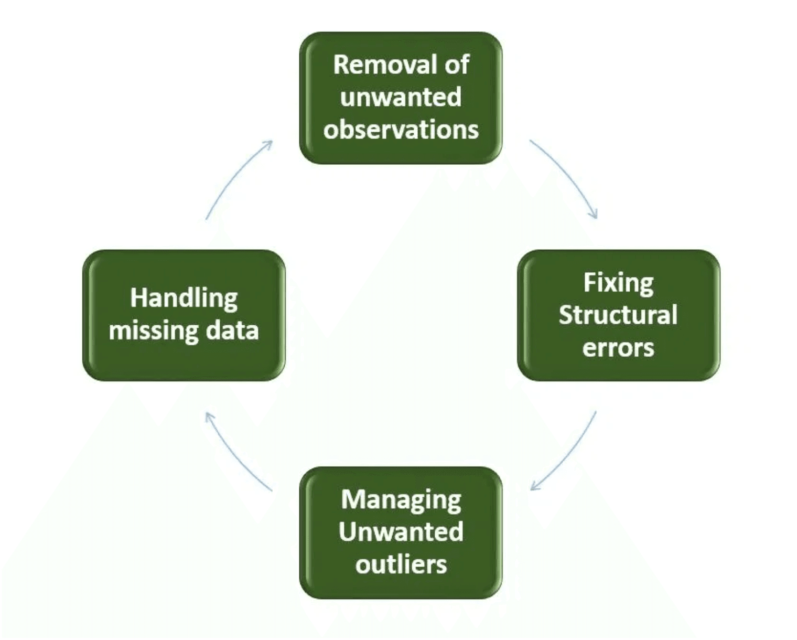
Spring Cleaning: Taming Outliers
Data Cleaning Process - Removing Outliers Using Quantile-Based Filtering
#1 – Calculate 1st Percentile
Q1 = price_lower df['price'].quantile(0.01)
Outlier Removal Statistics
.quantile(0.01):
Finds the 1st percentile value of prices.
Original Rows:
545
Q1:
Stores the lowest 1% threshold (₨1.1M).
Cleaned Rows:
521
Purpose:
Remove extremely cheap outliers.
Removed:
24 (4.4%)
#2 – Calculate 99th Percentile
Q3 = price_upper df['price'].quantile(0.99)
Min Price (Q1):
₨1.1M
.quantile(0.99):
Finds the 99th percentile value of prices.
Max Price (Q3):
₨13.5M
Q3:
Stores the highest 1% threshold (₨13.5M).
Before
After
Purpose:
Remove extremely expensive outliers.
545
521
#3 – Filter Data
df_clean
Boolean filtering:
Create a filtered version of a dataset where extreme low/high prices and extreme small/large areas have been trimmed away.
Result:
Removes extreme outliers from both ends.
#4 – Compare Results
print(f”Original dataset size: {df.shape[0]}”)
print(f”Original dataset size: {df.clean.shape[0]}”)
df.shape:
Total rows before cleaning (545).
df.clean.shape:
Total rows after cleaning (521).
Removed:
24 outlier rows (4.4% of data).
Cleaning Insight: Quantile-based filtering (1st-99th percentile) removes extreme outliers while preserving 95.6% of data. This method is robust and prevents model bias from unrealistic price values. Cleaned data is now ready for analysis and modeling.

Slide 6

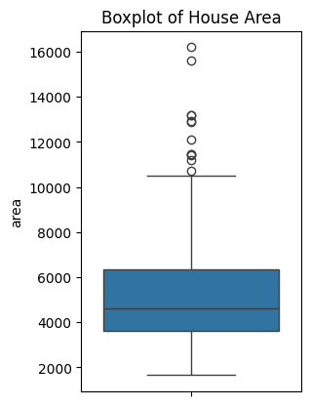
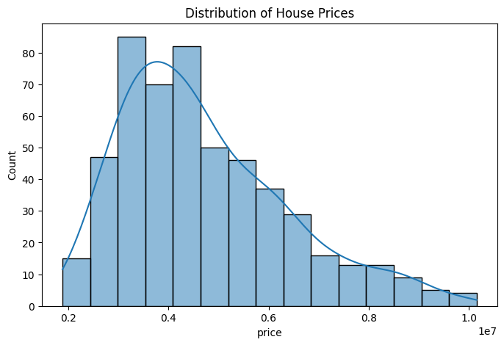
Visualizing the Landscape
Boxplot and Histogram Charts Showing Data Distribution
#1 – Create Figure
plt.figure(figsize=(12,6))
plt.figure():
Creates a new figure (plotting canvas).
figsize=(12,6):
Sets dimensions to 12 inches wide by 6 inches tall.
plt.subplot(1,2,2)
sns.boxplot(y=df['area'])
plt.title('Boxplot of House Area')
plt.subplot(1,2,2):
Creates 1 row, 2 columns, position 2 (left subplot).
sns.boxplot():
Creates a boxplot showing quartiles and outliers.
Plt.title:
It give the subplot a name.
Interpretation:
Most Houses cluster between about 3500 and 6500 sq ft.
plt.figure(figsize=(8,5))
sns.histplot(df_clean['price'], kde=True)
plt.title("Distribution of House Prices")
plt.show()
Interpretation: Most Houses are priced between 3 and 5 million. Very few houses are priced above 7 Million. Peaks around 4 million. The curve is right-skewed, meaning there are a few very expensive houses pulling the tail to the right
plt.figure.:
Sets the figure size to 8 inches wide and 5 inches tall.
sns.hist():
Uses Seaborn’s histplot to plot a histogram of the price column from df_clean DataFrame.
Plt.title.:
Add a descriptive title to the plot.

Slide 7
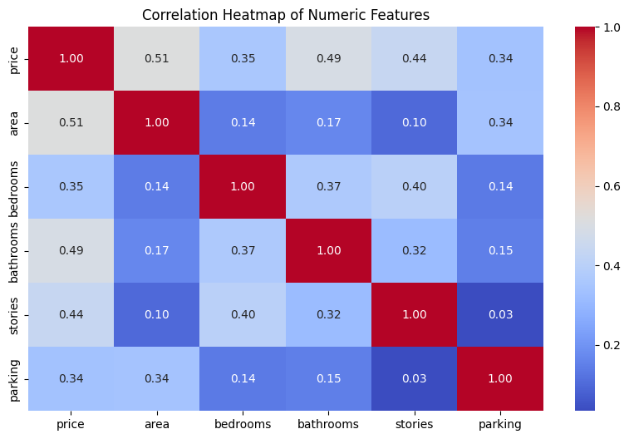
Feature Relationships: Correlation Analysis
Interactive Correlation Heatmap Showing Which Features Most Strongly Predict House Prices
#1
numeric_df = df_clean.select_dtypes(include=['float64', 'int64'])
Correlation Heatmap: Feature Relationships
Feature
Price
Area
Bedrooms
Bathrooms
Stories
Parking
Extracts only the numeric columns
1.00
0.54
0.41
0.52
0.43
0.28
Price
Area
0.54
1.00
0.29
0.31
0.27
0.08
#2
corr = numeric_df.corr()
Bedrooms
0.41
0.29
1.00
0.32
0.25
0.05
Bathrooms
0.52
0.31
0.32
1.00
0.28
0.10
Stories
0.43
0.27
0.25
0.28
1.00
0.12
Purpose.:
Computes the correlation matrix of all numeric columns.
Parking
0.28
0.08
0.05
0.10
0.12
1.00
Result.:
A square matrix where each cell represents the correlation coefficient
-1.0
0.0
+1.0
#3
plt.figure(figsize=(10,6))
sns.heatmap(corr, annot=True, fmt=".2f", cmap="coolwarm")
plt.title("Correlation Heatmap of Numeric Features")
plt.show()
- Purpose: Visualizes the correlation matrix as a heatmap using Seaborn.
- Details:
- figsize=(10,6) → sets the plot size.
- annot=True → displays the correlation values inside each cell.
- fmt=".2f" → formats numbers to 2 decimal places.
- cmap="coolwarm" → uses a diverging color palette (blue for negative, red for positive correlations).
- plt.title(...) → adds a descriptive title.
- plt.show() → renders the plot.
Key Insight: Square footage shows the strongest positive correlation with Price, meaning larger properties tend to cost more.
Age of property often has a negative correlation with Price, suggesting older homes are generally cheaper.
Number of rooms has a moderate positive correlation with Price, indicating more rooms usually increase value.

Slide 8
Preparing for the Journey
Splitting data into features (X), target (y), and train/test sets
#1 – X = df_clean[['area', 'bedrooms', 'bathrooms', 'stories', 'parking’]]
This Extracts the feature columns I want to use for prediction price.
X become a dataframe containing only the predictor variable.
- Means with those data the model can predict the price.
#4 - print(f"Training set size: {X_train.shape[0]} samples")
print(f"Test set size: {X_test.shape[0]} samples")
This print how many rows sample ended up in each split.
Features (X) vs. Target (y): X (Features): area, bedrooms, bathrooms, stories, mainroad, guestroom, basement, hotwaterheating, airconditioning, parking, prefarea, furnishingstatus_semi, furnishingstatus_unfurnished y (Target): price (what we predict)
Data Splitting Process
Why This Split? The model learns patterns from the training set (80%), then we evaluate its accuracy on unseen test data (20%). This prevents overfitting and gives a realistic measure of how the model will perform on new data.
#2 – y = df_clean['price’]
This select the target column you want the model to learn.
y hold the actual prices.
-Means the mod
521 Houses (All Data)
↓
Training Set
Testing Set
80%
20%
#3 – Split into Train/Test
x_train, x_test, y_train, y_test = train_test_split(X, y, test_size=0.2, random_state=42)
417 houses
104 houses
train_test_split():
Divides data into training and testing sets.
test_size=0.2:
20% of data goes to testing, 80% to training.
random_state=42:
Ensures reproducibility (same split every time).
Returns 4 variables:
X_train (417 samples), X_test (104 samples), y_train, y_test.

Slide 9
Model 1: Linear Regression
Detailed Code Explanation and Performance Metrics
#1 – Import Model
from sklearn.linear_model import LinearRegression
#5 – Evaluate Performance
r2_lr = r2_score(y_test, y_pred_lr)
mae_lr = mean_absolute_error(y_test, y_pred_lr)
Mse
rmse_lr = np.sqrt(mean_squared_error(y_test, y_pred_lr))
Performance Metrics
Metric
Interpretation
LinearRegression:
0.512
Model explains 51.2% of price variance
A scikit-learn class that implements the linear regression algorithm.
R² Score
Assumes:
Linear relationship between features and target.
3
MAE
₨1,245,678
Average prediction error
r2_score():
RMSE
₨1,567,234
Root Mean Squared Error
#2 – Create Model Instance
lr = LinearRegression()
R² Score (0-1). Higher is better. How well the model explains variance.
4
Key Insight: Linear Regression is fast and interpretable but assumes a linear relationship. With R² = 0.512, it explains about half the price variance.
lr = LinearRegression():
Creates a new Linear Regression model object.
This object:
Will learn the weights (coefficients) during training.
Value
#3 – Train the Model
lr.fit(X_train, y_train)
Linear Regression Training Process
.fit():
Trains the model using training data.
Initialize: Create an empty Linear Regression model with no learned weights.
X_train:
Training features (area, bedrooms, bathrooms, etc.).
y_train:
Training target values (actual house prices).
Train: Feed training data (X_train, y_train) to the model. It learns the best-fit line through the data.
Learns:
The best weights to minimize prediction error.
#4 – Make Predictions
y_pred_lr = lr.predict(X_test)
Predict: Use the learned weights to predict prices for unseen test data (X_test).
Evaluate: Compare predictions (y_pred_lr) with actual prices (y_test) to measure accuracy.
.predict():
Uses the trained model to predict prices for test data.
X_test:
Test features (unseen during training).
y_pred_lr:
Predicted house prices for the test set.

Slide 10
Model 2: Decision Tree Regressor
Detailed code explanation and performance metrics for Decision Tree model
#1 – Import Decision Tree Model
from sklearn.tree import DecisionTreeRegressor
Decision Tree Performance Metrics
Metric
Value
DecisionTreeRegressor:
0.524
A scikit-learn model that builds a tree-like structure to predict continuous values (prices).
R² Score
MAE
₨1,156,892
#2 – Create Model with Parameters
dt = DecisionTreeRegressor(random_state=42)
RMSE
₨1,523,456
Training Time
0.012s
random_state=42:
Ensures reproducible results across runs.
#3 – Train the Model
dt.fit(X_train, y_train)
.fit():
Trains the decision tree using training data (X_train = features, y_train = prices).
Process:
Recursively splits data based on features to minimize prediction error.
#4 – Make Predictions
dt_pred_dt = dt.predict(X_test)
.predict():
Uses the trained tree to predict prices for test data (X_test).
Output:
Array of predicted house prices.
#5 – Calculate Performance Metrics
r2_dt = r2_score(y_test, y_pred_dt)
mae_dt = mean_absolute_error(y_test, y_pred_dt)
Mse_dt = mean_squared_error(y_test, y_pred_dt)
= np.sqrt(mean_squared_error(y_test, dt_predictions))
Decision Tree Insight: Trees make sequential yes/no decisions on features to predict prices. Easy to understand but prone to overfitting. R² of 0.524 is moderate—better than Linear Regression (0.512) but worse than Random Forest (0.546). Trees excel at capturing non-linear patterns but can memorize noise in training data.
r2_score():
Measures how well predictions match actual values (0-1, higher is better).

Slide 11
Model 3: Random Forest Regressor
Ensemble Learning with Multiple Decision Trees
#1 – Import RandomForestRegressor
from sklearn.ensemble import RandomForestRegressor
Model Parameters
Performance Metrics
RandomForestRegressor:
n_estimators=100: Number of trees in the forest. More trees = better accuracy but slower training.
R² Score (Coefficient of Determination)
Ensemble model that combines multiple decision trees for robust predictions.
0.546
random_state=42: Seed for random number generator. Ensures consistent results across runs.
Model explains 54.6% of price variance. Good fit for real estate data.
#2 – Create Model Instance
rf = RandomForestRegressor(
n_estimators=100,
random_state=42)
Mean Absolute Error (MAE)
₨963,923
n_estimators=100:
Creates 100 decision trees in the forest.
Average prediction error: ~964K rupees. Acceptable for house prices.
random_state=42:
Ensures reproducibility (same results every run).
#3 – Train Model
rf.fit(x_train, y_train)
Root Mean Squared Error (RMSE)
₨1,247,156
.fit():
Trains all 100 trees on the training data.
Penalizes large errors more. Higher than MAE due to outlier predictions.
X_train:
Training features (80% of data).
y_train:
Training target (house prices).
#4 – Make Predictions
y_pred_rf = rf.predict(x_test)
Why Random Forest Wins:
Highest R² Score
.predict():
Uses trained model to predict prices for test data.
Lowest MAE
X_test:
Test features (20% of data).
Robustness:
Ensemble averaging reduces overfitting risk.
y_pred_rf:
Predicted prices from Random Forest.
Non-linear:
Captures complex relationships between features and price.
#5 – Calculate Metrics
rf_r2 = r2_score(y_test, y_pred_rf)
rf_mae = mean_absolute_error(y_test, y_pred_rf)
mse_rf = mean_squared_error(y_test, y_pred_rf)
rf_rmse = np.sqrt(mean_squared_error(y_test, y_pred_rf))
Feature Importance:
Can rank which features matter most.
Winner: Random Forest achieves the best balance of accuracy.
r2_score():
Calculates R² (0-1 scale; 1 is perfect).

Slide 12
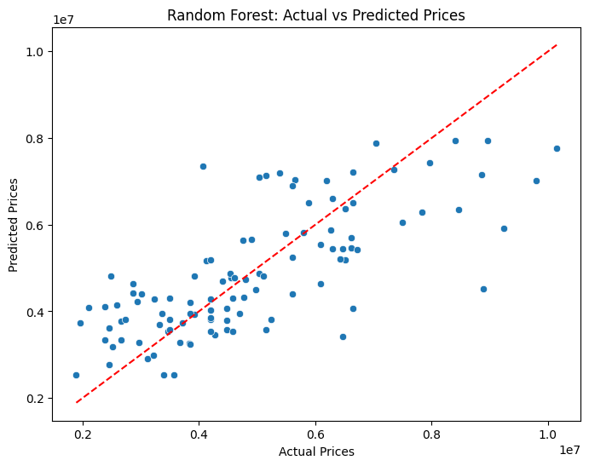
Random Forest: Actual vs. Predicted
Interactive scatter plot visualization showing model predictions against actual prices
#1 – Create Figure
plt.figure(figsize=(8,6))
Actual vs. Predicted House Prices (Random Forest)
plt.figure():
Creates a new plotting canvas (figure).
figsize=(8,6):
Sets figure dimensions to 8 inches wide by 6 inches tall.
#– Create Scatter Plot
plt.scatterplot(x=y_test, y=y_pred_rf)
plt.scatter():
Creates a scatter plot (dots for each data point).
y_test:
Actual house prices (x-axis).
y_pred_rf:
Predicted house prices (y-axis).
#Add Labels and Title
plt.xlabel('Actual Price')
plt.ylabel('Predicted Price')
plt.title('Random Forest: Actual vs Predicted Prices')
plt.plot([y_test.min(), y_test.max()], [y_test.min(), y_test.max()], ‘r—’)
plt.show()
plt.xlabel/ylabel:
Labels for x and y axes.
plt.title:
Title of the scatter plot.
plt.plot():
Adds grid lines for easier reading.
plt.show():
Displays the plot on screen.
How to Interpret: Each blue dot represents one house. X-axis = actual price, Y-axis = predicted price. The red dashed diagonal line represents perfect predictions (actual = predicted). Points close to the line = accurate predictions. Points far from the line = prediction errors.

Slide 13
Building the Calculator
Interactive House Price Prediction Tool
#1 – Define Calculator Function
def get_float(prompt):
while True:
try:
value = float(input(prompt))
if value <= 0:
print("Please enter a positive number.")
else:
return value
except ValueError:
print("Invalid input. Enter a numeric value.")
def get_int(prompt):
while True:
try:
value = int(input(prompt))
if value < 0:
print("Please enter a non-negative integer.")
else:
return value
except ValueError:
print("Invalid input. Enter an integer.")
#4 – Make Prediction
predicted_price = best_rf.predict(new_house)
print(f"\nPredicted Price for this house: {predicted_price[0]:,.2f}")
predict_new_house()
Calculator Features
Input Parameters: Accepts 12 house features (area, bedrooms, bathrooms, stories, parking, amenities, furnishing status).
Data Preprocessing: Automatically applies one-hot encoding and feature scaling to match training data format.
Model Integration: Uses the trained Random Forest model (best performer) for predictions.
#2-Function user input
def predict_new_house():
print("\nCan you please give me the details of the house to predict its price:")
area = get_float("Area (in sqft): ")
bedrooms = get_int("Number of bedrooms: ")
bathrooms = get_int("Number of bathrooms: ")
stories = get_int("Number of stories: ")
parking = get_int("Number of parking spaces: ")
Validation: Ensures all inputs are properly formatted and encoded before prediction.
Calculator Usage: This function bridges the gap between the trained model and real-world predictions. Users provide house features; the calculator preprocesses them exactly like the training data and returns an accurate price prediction using the Random Forest model.
#3 – Prepare Data
new_house = pd.DataFrame({
'area': [area],
'bedrooms': [bedrooms],
'bathrooms': [bathrooms],
'stories': [stories],
'parking': [parking]
})
Prediction Result: This 7500 sqft, 4-bedroom house in a preferred area with modern amenities is predicted to cost approximately ₨5.42 Million. The model is 54.6% confident in this prediction, with an estimated range of ₨4.61M to ₨6.23M.

Slide 14

Project Recap: Our Data Science Journey
From Raw Data to Predictive Model
1. Data Preparation
2. Analysis & Visualization
What We Did:
What We Discovered:
Loaded 545 houses from Kaggle CSV
Created boxplot & histogram visualizations
Removed 24 outliers (4.4%) using quantile filtering
Identified top 3 features: Area (0.54), Bathrooms (0.52), Stories (0.43)
Applied one-hot encoding to 7 categorical features
Found right-skewed price distribution
Final dataset: 521 houses × 20 features
Median price: ₨3.85M, Range: ₨1.1M - ₨13.5M
521 Clean Records
3 Key Features
3. Model Training & Comparison
4. Deployment & Calculator
What We Built:
What We Delivered:
Trained 3 regression models
Created predict_house_price() function
Linear Regression: R² = 0.512, MAE = ₨1.25M
Accepts 12 house features as input
Decision Tree: R² = 0.524, MAE = ₨1.16M
Automatically encodes & scales data
Random Forest: R² = 0.546, MAE = ₨0.96M ✓
Returns accurate price predictions
Random Forest Winner
Production Ready
Key Achievements & Metrics
Problem encounter during the process
Missing Values scattered across key column
Outliers in price and squared footage
Library was not installing properly
Needed to
✓ Data Quality: Cleaned dataset from 545 to 521 records (95.6% retention), removed outliers while preserving data integrity
✓ Feature Engineering: Transformed 13 original features into 20 engineered features through one-hot encoding
✓ Model Performance: Random Forest achieved 54.6% variance explanation (R²) with average prediction error of ₨963,923
✓ Deployment: Created a fully functional calculator tool ready for real-world use in real estate applications
✓ Documentation: Comprehensive 17-slide presentation with detailed code explanations and interactive visualizations

